Slide 1
MacLean’s Triune Brain Theory

Slide 2
What is it?
a model of the evolution of the vertebrate forebrain and behavior
American physician and neuroscientist Paul D. MacLean (1960; 1990)
triune brain consists of the reptilian complex, the paleomammalian complex (limbic system), and the neomammalian complex (neocortex)
viewed as structures sequentially added to the forebrain in the course of evolution.

Slide 3
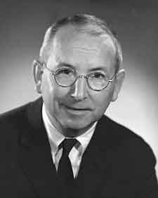
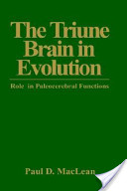

Slide 4
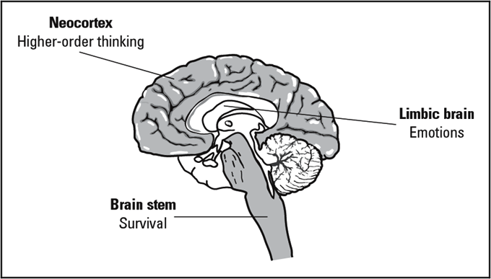

Slide 5
Reptilian Brain or R-Complex
Oldest part of the brain developed during the Triassic Period (248-206 million years ago)
Shared with reptiles like lizards, snakes, and even fish.

Slide 6
Characterized By
Survival – Regulates body functions like breathing, eating, circulation, motor functions, balance, etc.
Non-verbal – Functions are beyond conscious control; no language, no reasoning, instinct only.
Physical – Concerned with the physical conditions of our existence (hunger, sleep, sex)

Slide 7
Continued
Habitual – Likes to know what’s going to happen based on past experiences/routines and develops habits to support survival; doesn’t deal well with change.
Territorial – Protects “my space and my things.”
Fight/Flight/Freeze – Response to perceived danger is automatic: to attack, to run, or become paralyzed with fear

Slide 8
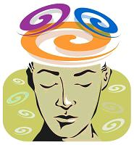
The Limbic Brain or Emotional Brain
Evolved during the Jurassic Period (206-144 million years ago.
Shared with older mammals like cats, dogs, and rats.
Called the “Gatekeeper.” Uses emotion to make meaning and reactions in any situation
Safe = Cortex
Threat = Brainstem
Provides the emotional coding to our memories, which tells us which memories are important, making those memories easier to retain and recall
911

Slide 9
Characterized By
Emotions – Determines our emotional state and modifies perceptions and responses. Connected to our feelings and “gut reactions.”
Social – Needs to share and be a part of a social group
Group Responsibility – Encourages care for others in the group (family, youth, social group, etc.)
Hormones are regulated (or not)

Slide 10
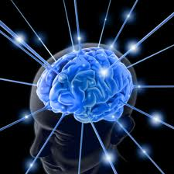
Neocortex or Cerebral Cortex
Evolved during the Eocene and Oligocene periods (55-24 million years ago)
Shared with primates like chimps.
Gray mass or “Thinking” brain (85%)

Slide 11
Characterized By
Consciousness – Responsible for academic learning
Language – Complex processes which happen in ONLY this part of the brain
Meaning – Actively makes meaning from the world and seeks to detect/understand patterns
Abstractions – Problem-solving and abstract thinking for use in logic, inventions, visualization and all higher-order thinking skills

Slide 12
Continued
Symbols – Written language, numbers, musical notes, formulas…Neocortex LOVES them!
Voluntary – Controls our voluntary actions, NOT reactionary. It can push the “pause” button.

